Slide 1


ICC Men's T20 World Cup 2022: Data Analysis

Slide 2


Content Table
1
Introduction
2
Objectives
3
Tools
4
Data Overview
5
Dashboard Insight
6
Overview Panel
7
Batting and Bowling Analysis
8
Player Performances
9
Conclusion

Slide 3


Introduction
The T20 World Cup is a major international cricket tournament. This analysis aims to provide insights into the tournament's key moments, player performances, and overall trends.

Slide 4



Objectives
1
Identify Top Performers
2
Explore Performance Trends
Analyze individual and team batting and bowling statistics to identify the top performers of the tournament.
Examine how batting and bowling strategies evolved throughout the tournament.
3
Uncover Key Insights
4
Generate Recommendations
Discover insights into factors that influenced batting and bowling success.
Provide actionable recommendations for future tournaments based on the analysis.

Slide 5


Tools
Power BI
Power BI is a powerful data visualization and analysis tool that allows us to create interactive dashboards and reports. It enables us to transform raw data into insightful visuals.
POWER BI
Kaggle
Kaggle is a platform for data scientists and machine learning practitioners. It provides access to a vast collection of datasets, including data from the T20 World Cup.

Slide 6


Data Overview
The dataset includes comprehensive information on every match played in the T20 World Cup 2022. This data encompasses player statistics, team scores, match details, and venue information. We analyze this data to understand the trends and patterns that emerged during the tournament.

Slide 7

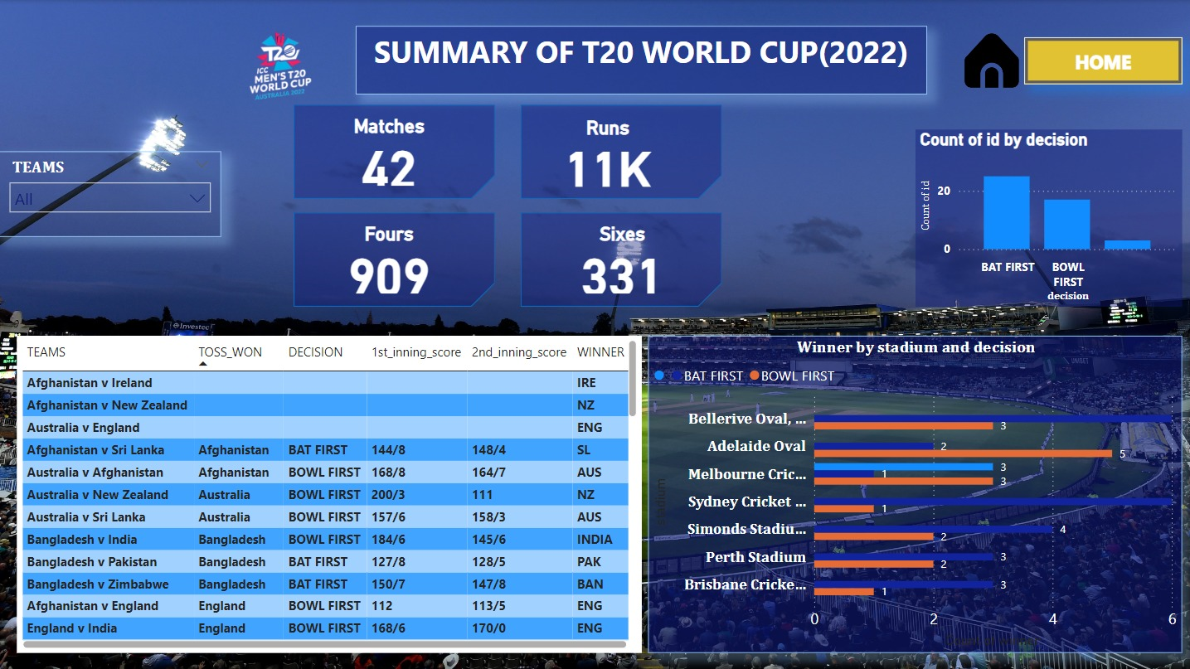
Dashboard Insights
Match Statistics
Player Performance
The dashboard provides a detailed overview of match statistics, including scores, wickets, and boundaries. This allows us to visualize the key moments and turning points of each match.
The dashboard highlights individual player performance, such as runs scored, wickets taken, and strike rates. This helps us identify the top performers and emerging talent.

Slide 8

Overview Panel
The dashboard's overview panel provides a summary of key metrics, such as the top-performing teams, leading run-scorers, and most successful bowlers.

Slide 9
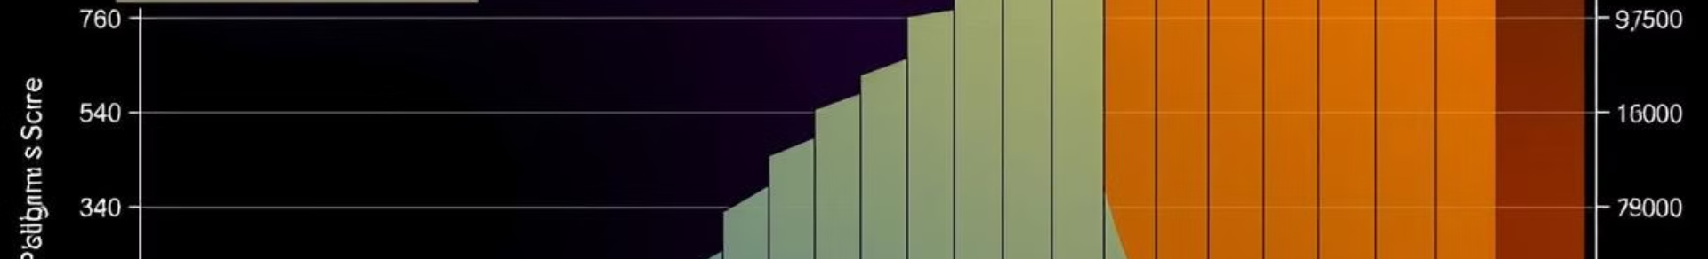
Batting and Bowling Analysis
Batting
Bowling
Analyzes the batting averages of individual players, providing
insights into consistent performance and batting form.
Analyzes the bowling averages of individual bowlers, providing
insights into their consistency and effectiveness.
Identifies the highest individual scores in the tournament,
highlighting exceptional batting performances.
Identifies the best bowling figures achieved in a single match,
highlighting standout bowling performances.

Slide 10

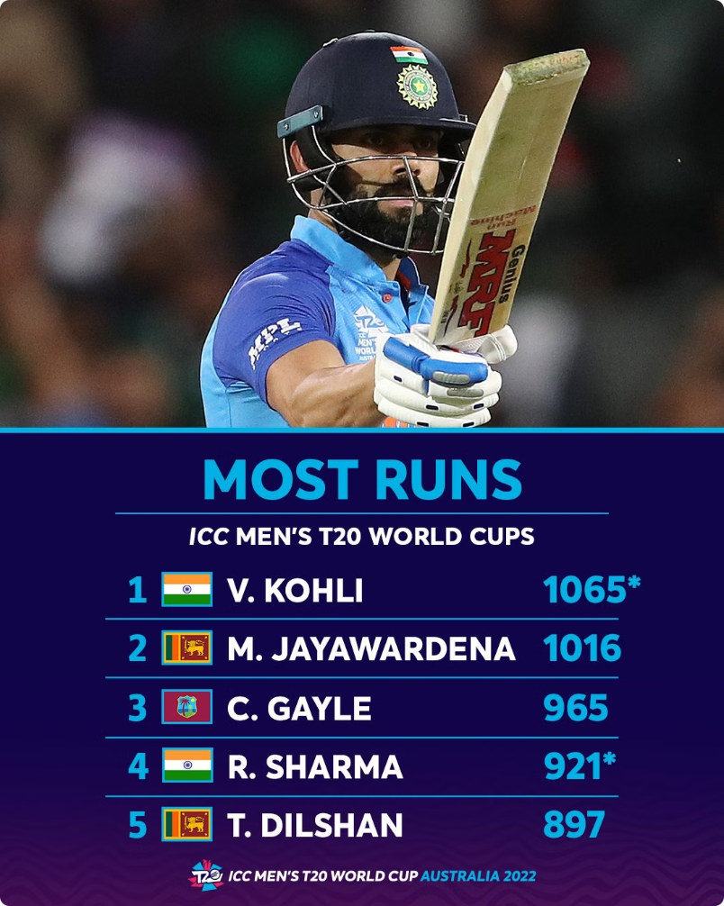
Player Performances
1
Group Stage
Analysis of individual player performance during the group stage matches.
2
Super 12
Analysis of individual player performance during the super 12 matches.
3
Knockout Stages
Analysis of individual player performance during the semi-finals and finals.

Slide 11
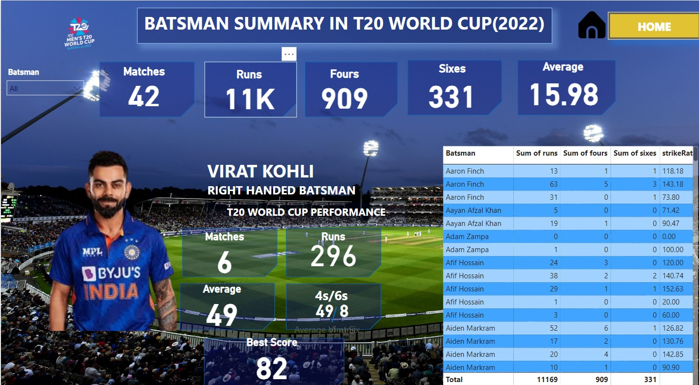

Slide 12
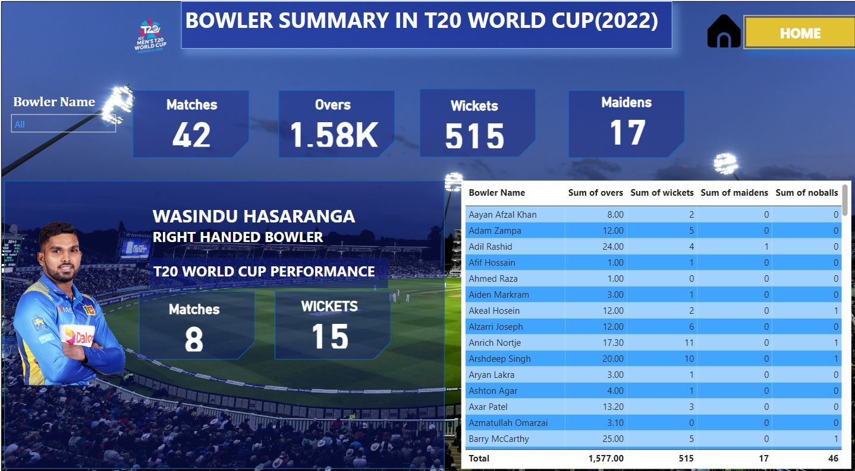

Slide 13


Conclusion
The analysis reveals valuable insights into batting and bowling strategies in T20 cricket. This data can be used to further refine strategies and prepare for future tournaments. Future work will explore the impact of venue factors, player fatigue, and data-driven decision-making.

Slide 14
THANK YOU

